Slide 1
TOKOH INSPIRATIF MUDA .

Slide 2

TOKOH INSPIRATIF MUDA .

Slide 3
But, how?
TOKOH INSPIRATIF MUDA .

Slide 4
VIDEO MUST BE HERE
TOKOH INSPIRATIF MUDA .

Slide 5
Do What you love, love what you do .
TOKOH INSPIRATIF MUDA .

Slide 6
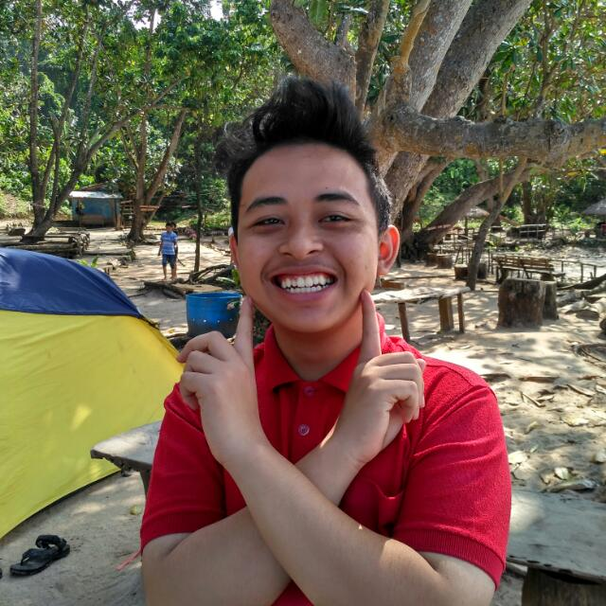
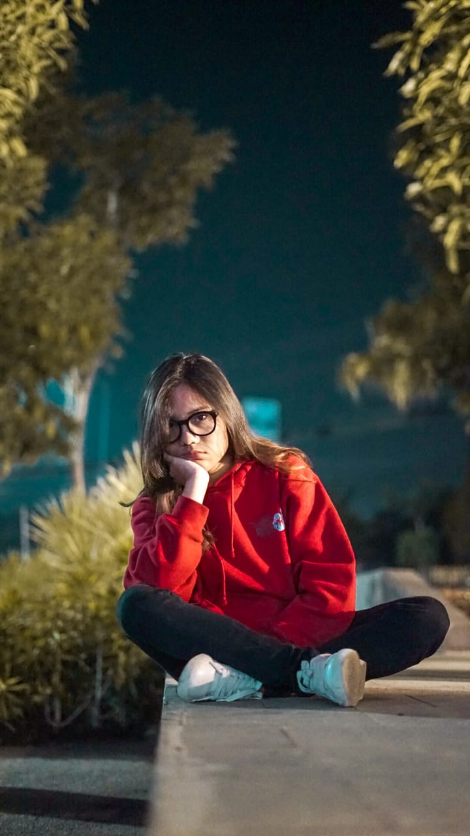
That’s 5 minutes, see you next week .
Panji Iman Baskoro
171111023
“My assignment is recently overdue”
Luna
“My assignment is recently overdue”
TOKOH INSPIRATIF MUDA .

